Slide 1
Industrial Exposure Session: PX4 and ArduPilot – Foundations of Open-Source Autopilot Systems
Rohan More
Senior Software Engineer

Slide 2
Agenda
Introduction to PX4 and ArduPilot
India Towards Indigenization
System Architecture & Components
PX4 vs ArduPilot vs ROS Comparison
Development Setup on Ubuntu
QGroundControl Simulation Demo
Industrial Case Study on GPS

Slide 3
Journey So Far
🎓 Education: B.Tech / M.Tech in Mechatronics
🧩 Specialization: Embedded systems, UAV autonomy, ROS2, QGC Development, Solution Architect
🛠️ Projects:
Integrated PX4 and ArduPilot on Pixhawk boards for autonomous drone testing
Developed custom offboard control scripts using pymavlink and MAVROS
Worked with QGroundControl for flight mission setup and SITL testing
Ardupilot Porting on STM32 Boards
🌍 Industry Exposure:
Worked on UAV system integration and autopilot customization
Research on encrypted firmware bootloaders for secure UAV updates
Solution Architect
🚀 Current Focus: Bridging academic learning with industrial UAV practices and Solution Architect building for Recent UAV

Slide 4
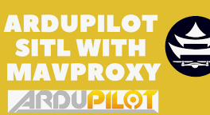
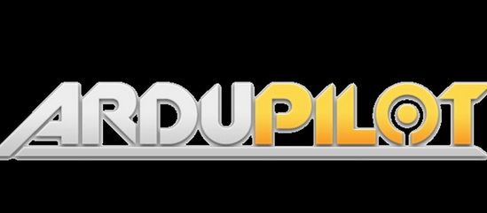
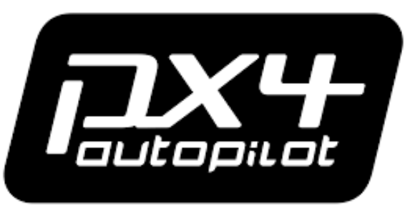

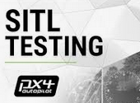
Welcome & Objectives
✈️ Goal: Understand PX4, ArduPilot, and how to connect with QGroundControl
Outcomes:

Slide 5
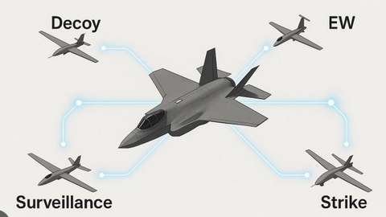
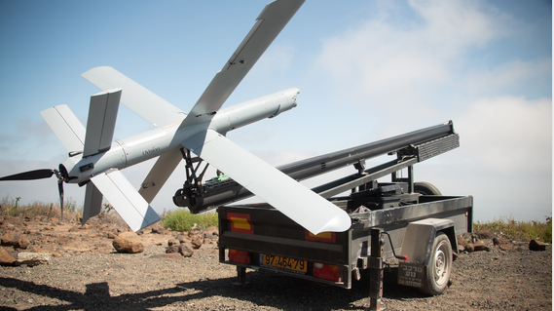
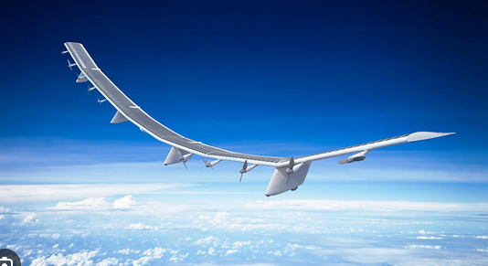
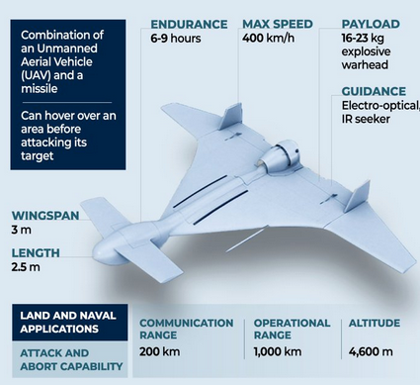
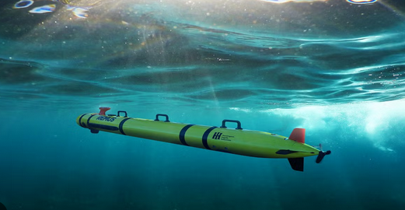
Emerging Industrial Trends in Autonomous Platforms
Loitering Munitions
CCA
HAPS
🚀 New Directions Beyond Traditional Drones
UUV

Slide 6
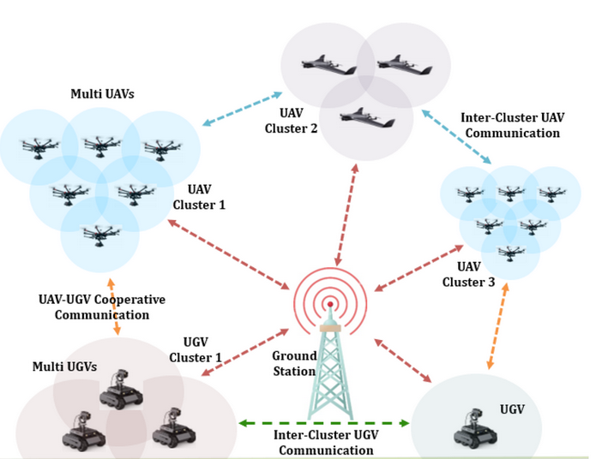
Collaborative Mesh Network

Slide 7
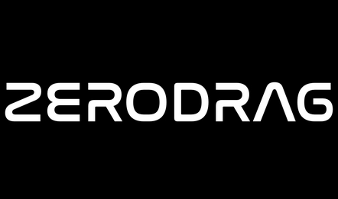


Indigenization in UAV Technology: Building Self-Reliant Drone Ecosystems in India
“By mastering open-source platforms like PX4 and ArduPilot, Indian engineers can customize, innovate, and localize UAV technologies — making India not just a user, but a global leader in autonomous systems.”
Domain | Goal | Indian Opportunity
Flight Controllers | Develop PX4/ArduPilot compatible Indian hardware (Pixhawk alternatives) | HAL, Bharat Electronics, IIT start-ups, Botlab Dynamics, ZeroDrag
Sensors & IMUs | Replace imported GPS, barometers, and IMUs | DRDO labs, MSMEs developing MEMS sensors
Communication Modules | Indigenous telemetry, RF, and 4G/5G modules | Local RF design and manufacturing
Power Systems | Indian-made Li-ion cells and BMS systems | ISRO, private energy startups
Software & Autonomy | Build AI, computer vision, and PX4/ArduPilot forks in India | Open-source collaboration, academia-industry R&D

Slide 8
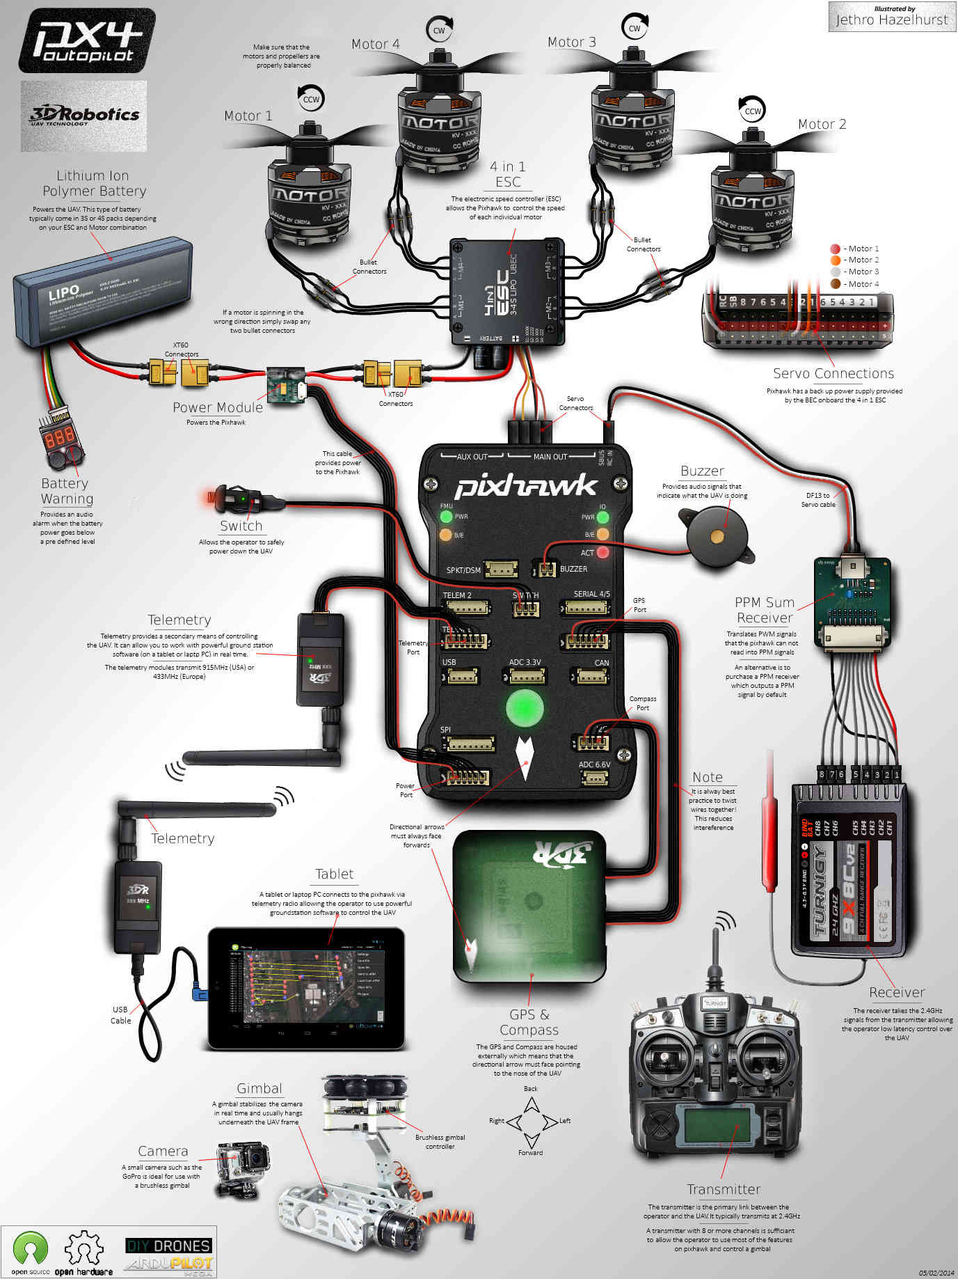
Drone Basic Components
Category | Component | Function (in brief)
🛠️ Structure | Frame | Holds all parts together; provides shape and stability.
⚙️ Propulsion System | Motors, Propellers, ESCs | Generate thrust and control drone movement.
🔋 Power System | Battery, Power Distribution Board (PDB) | Supplies and distributes electrical power to components.
🧠 Flight Controller | Pixhawk, Cube, Navio2, etc. | The “brain” — processes sensor data and stabilizes flight.
📡 Sensors | IMU, GPS, Compass, Barometer, LiDAR | Provide position, orientation, and environmental data.
📶 Communication System | Radio Receiver, Telemetry Module | Enables control and data exchange between drone and ground.
💻 Ground Control Station (GCS) | QGroundControl, Mission Planner | Interface for monitoring, mission planning, and control.
🎯 Payload | Camera, Sprayer, Delivery Box, etc. | Mission-specific component for data capture or delivery.
🧩 Software Stack | PX4, ArduPilot, MAVLink | Autopilot firmware and communication software.

Slide 9
Selecting a Components
Factor | Description | Example UAV Type / Application
1️⃣ Altitude Capability | Maximum height the UAV can operate efficiently. | High-Altitude Long-Endurance (HALE) drones like Zephyr, HAPS, Heron for surveillance or communication relays.
2️⃣ Endurance | Flight duration before battery/fuel exhaustion. | Long-Endurance UAVs (e.g., MQ-9 Reaper, IdeaForge Netra V4) for border patrol or mapping.
3️⃣ Payload Capacity | Weight UAV can carry (camera, sensors, cargo). | Delivery drones, LiDAR survey drones.
4️⃣ Range / Communication Radius | Distance UAV can operate from Ground Control Station. | BVLOS drones for delivery or pipeline inspection.
5️⃣ Flight Time & Power Source | Depends on battery, solar, or hybrid power. | Solar UAVs (Zephyr) or Hybrid Fuel UAVs (Rustom).
6️⃣ Speed & Agility | Determines suitability for dynamic missions. | Racing drones, tactical strike UAVs.
7️⃣ Stability & Control System | Autopilot performance in windy/complex environments. | PX4/ArduPilot-based drones for stable autonomous missions.
8️⃣ Mission Profile | Purpose-specific design (survey, surveillance, delivery). | Mapping drones (DJI Phantom 4 RTK) or Agricultural drones (Garuda Kisan).
9️⃣ Regulatory Compliance | Meets DGCA or FAA rules for flight category. | NPNT-compliant Indian UAVs.
🔟 Cost and Maintenance | Affects operational scalability and affordability. | Low-cost quadcopters for education/training.

Slide 10
Explaining PX4 and ArduPilot in Layman’s Terms
🔹 The Researcher’s Brain
PX4 is like a flexible and modern autopilot system — designed for people who want to experiment, innovate, and build new types of drones. It’s highly modular
🔹 The Industry Veteran
ArduPilot is like a seasoned pilot — it’s older, very experienced, and can handle many types of vehicles, not just drones. It’s used in professional and commercial drones that need reliability and stability more than constant innovation.
Simple Metaphor to End With
“PX4 and ArduPilot are like the Android and iOS of drones — both do similar things, but each has its own style, community, and strengths. PX4 is more open and modular; ArduPilot is more mature and widely used.”

Slide 11
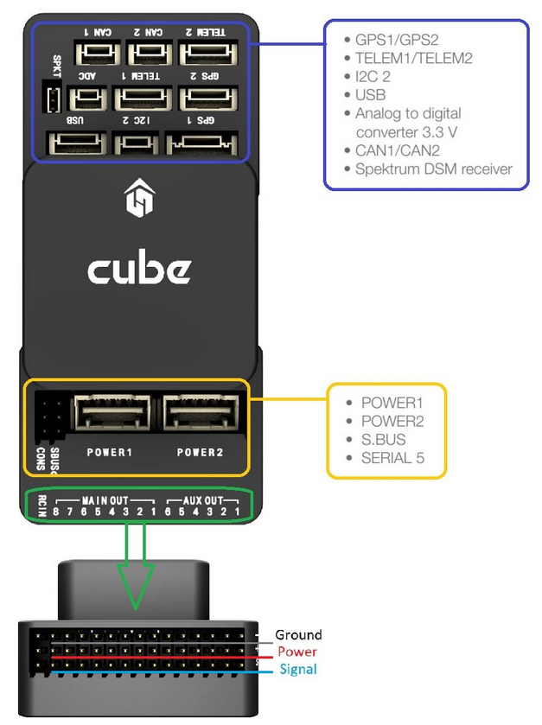
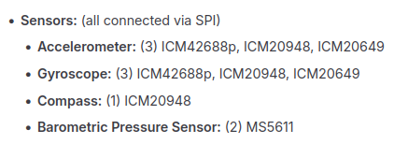
Hardware Anatomy

Slide 12
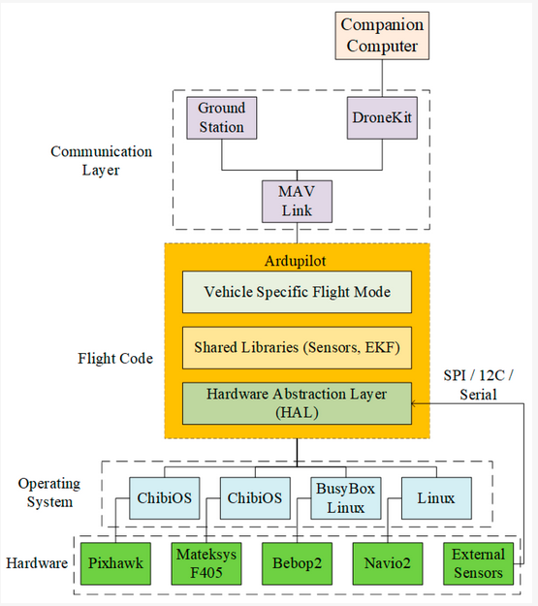
Software Anatomy
Main Layers:
🧩 HAL (Hardware Abstraction Layer) – Connects software to any hardware
⚙️ Drivers & Libraries – Sensor interfaces and core functions
🛫 Vehicle Firmware – ArduCopter, ArduPlane, ArduRover, etc.
🕹️ Control Loops – Stabilize and navigate using PID algorithms
📡 MAVLink Interface – Communication with GCS (QGC, Mission Planner)
💾 Parameter & Logging System – Save settings and flight data

Slide 13
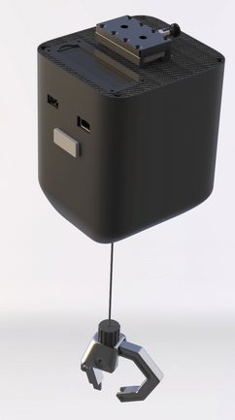
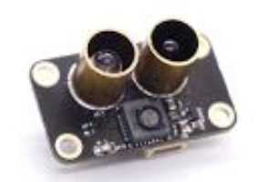
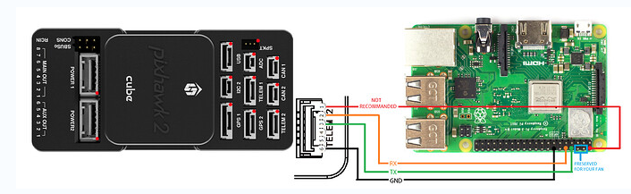
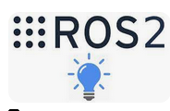
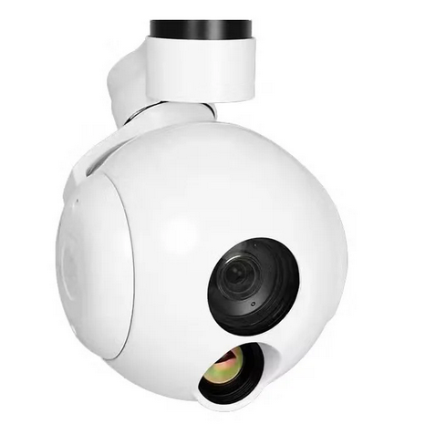
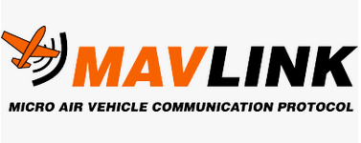
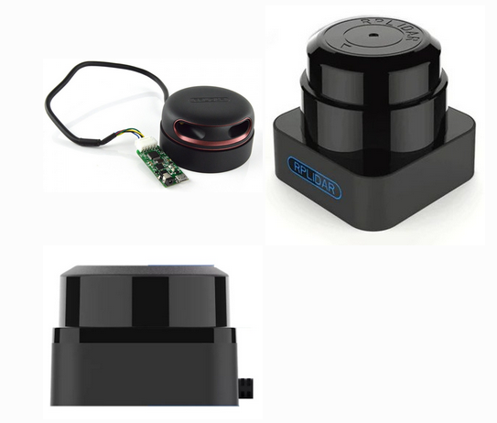
Make It More Intelligent
Flight Controller
ON Board COM
Optical Flow Sensor
RTSP Camera
Lidar

Slide 14
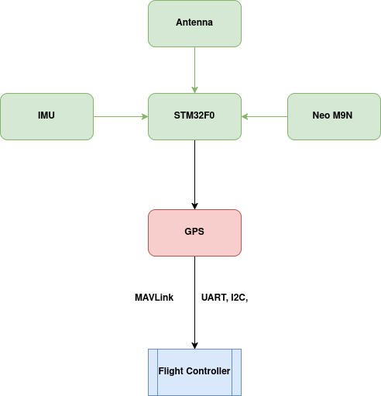
From Sensor to Mission: The Product Flow
Modular design for rapid integration
Based on open-source autopilot (PX4/ArduPilot)
Scalable for multiple UAV types
Supports Indian indigenization goals

